Slide 1



Topological Financial
Risk Optimizer
Predicting Market Crashes Before They Happen — Using Topology
Non-Euclidean Early Warning System for Structural Market Shattering
Department of Information Technology
Bharati Vidyapeeth’s college of Engineering, New Delhi
Presented By:
ANJALI PRIYADARSHI|DAKSH BATRA|PRATYUSH KUMAR RAI
04411503123|04311503123|00111503123
Mentor:
Dr. Neha Sharma
Assisitant Professor

Slide 2


Why do Crash Prediction Models Fail?
📉
📐
Reactive, Not Predictive
📉
Wrong Geometry
RSI, MACD, Bollinger Bands describe what already happened
ML assumes Euclidean space; crashes are non-Euclidean
⚖️
Crashes < 5% of days; broken model gets 90%+ accuracy with 0% Recall
🌊
Regime Blindness
Class Imbalance Trap
2020 model fails in 2024 (COVID ≠ rate hikes ≠ AI boom)
"Crashes are not statistical anomalies — they are structural phase transitions."

Slide 3
Data and Adaptive Target Formulation
DATA SOURCES
Yahoo Finance
Trading View
Library: yfinance ≥0.2.0
Library: tvDataFeed
Coverage: US equities, ETFs, crypto
Coverage: Indian NSE/BSE, fallback
Primary test asset: AAPL — Apple Inc., 2-year rolling window
Format: OHLCV daily bars
Minimum required: 60 trading days
The threshold is adaptive — a 1.5x ATR drop for volatile TSLA represents a larger absolute move than for stable MSFT. No fixed percentage threshold is used. The model scales to each stock's own volatility regime.
Train/Test Split: 80% / 20% chronological — no data leakage, no shuffle

Slide 4
Data and Adaptive Target Formulation
ADAPTIVE TARGET FORMULA
y[i] = 1 if (Close[i] − min(Close[i+1 : i+6])) ≥ ATR[i] × 1.5
y[i] = 0 otherwise
Close[i]
Closing price on day i
min(Close[i+1:i+6])
Minimum close over next 5 trading days
ATR[i]
14-day Average True Range — volatility normalizer
1.5x
Crash threshold multiplier (adaptive, not fixed %)
Window = 5 days
Forward-looking prediction window

Slide 5
What Existing Research Missed
PRIOR ART
Work | What They Did | Gap
Gidea and Katz(2017) | Static TDA on S&P 500 crash precursors | Snapshot topology only
Gidea & Katz (2018) | Betti numbers before 2008/2015 crashes | No velocity, no ML fusion
Bubenik (2015) | Persistence Landscapes for statistical ML | No financial application
LSTMs / Neural Nets | Sequential price prediction | Assumes Euclidean geometry
Standard RF / XGB | Technical indicator classification | No topological features

Slide 6
What Existing Research Missed
PRIOR ART
OUR CORE CONTRIBUTIONS
1
Manifold Velocity
3
Dynamic Micro-Regime Training
First derivative of persistence landscape; detects speed of topological shattering
Trailing 2-year window per ticker; no stale macro-topologies
2
Dual-Mode Architecture
Production (gradient penalization) vs Research (SMOTE) for different goals
Novelty = Gidea's topology + First Derivative + Ensemble ML fusion + Live deployment

Slide 7
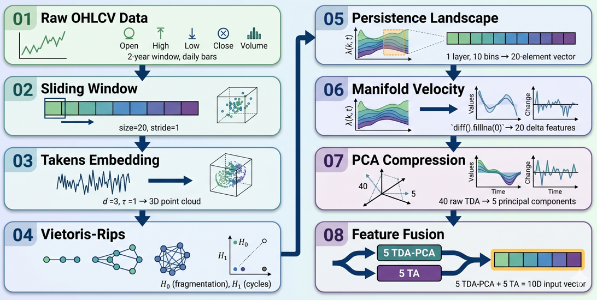
The TDA Approach — Seeing the Shape of Risk

Slide 8
The TDA Approach — Seeing the Shape of Risk
CORE INNOVATION
ENSEMBLE WEIGHTS [3:2:1]
• Static TDA detects odd-shaped markets
• Velocity TDA detects markets actively breaking apart
• A shattering manifold = imminent structural collapse
• First derivative catches crashes 5 days early
XGBoost (3)
Random Forest (2)
Logistic Regression (1)
40 TDA features on ~500 rows → severe overfitting. PCA retains dominant topological signal, discards noise.

Slide 9
Dual Mode Architecture- Production Ready
 | PRODUCTION | RESEARCH
Imbalance | Gradient Penalization scale_pos_weight = √(pos_ratio) | SMOTE Resampling · 1:1 class balance
Voting | Weighted [3:2:1] | Equal-weight
Data | 100% real market data | Pinned 2-year dataset
Goal | High accuracy · No false alarms | High recall · Prove TDA signal
Result | ~77.5% live accuracy | 78.65% accuracy · F1=0.5128
Stack: Python 3.12 · Giotto-TDA · XGBoost · scikit-learn · FastAPI · React 19 · Vite
Zero stored weights — model retrains from raw data on every API request. No pickle, no stale model.

Slide 10
Why the Lower Accuracy is more Meaningful?
"A model that guesses 'No Crash' every day achieves 87%+ accuracy with 0% Recall."
Metric | Naive 'Always Safe' | TFRO Ensemble
Accuracy | 87%+ (guaranteed) | 78.65% (deliberately lower)
F1-Score | 0.000 | 0.5128
MCC | 0.000 | +0.3764 (strong positive signal)
Why 78.65% Accuracy Is More Meaningful
MCC = +0.3764 on 87% majority-class data confirms genuine structural learning, not noise fitting.

Slide 11
Ablation Study: AAPL Dataset
Chronological 80/20 split · SMOTE on training only · No data leakage
Model Configuration | Accuracy | F1-Score | MCC
Baseline (TA Only) | 64.04% | 0.3333 | 0.0990
TDA Only | 56.18% | 0.0000 | -0.2805
Full Ensemble (TDA+TA) | 78.65% | 0.5128 | 0.3764
+14.61%
+53.85%
+280%
Accuracy vs TA-only baseline
Relative F1 improvement
MCC improvement
TDA alone has 0% Recall — topology detects anomalies but can't determine direction. Fusion with TA grounds the signal.

Slide 12
Sensitivity to Takens Embedding Dimensions
All parameters held constant · Full ensemble · Varying d ∈ {2, 3, 4, 5}
Dimension (d) | F1-Score | MCC
d = 2 | 0.4667 | 0.4051
d = 3 (optimal) | 0.5128 | 0.3764
d = 4 | 0.1224 | -0.2020
d = 5 | 0.2439 | 0.0178
Takens' Theorem (1981): for 1D time series, d = 2m+1 = 3 is the minimal sufficient reconstruction. d ≥ 4 overfits on ~500 rows.

Slide 13
Live System Results: AAPL Project Suite
25
94.2%
77.5%
TARGET : AAPL | PRICE: $210.45
Risk Level : LOW
Risk Score : 25 / 100
Confidence : 94.2%
Backtest Acc : 77.5%
Ensemble : [3:2:1] XGB/RF/LR
Risk Score
Confidence
Accuracy
RETAIL ADVICE
🛡️
💰
📊
Safety Net
Spending Limit
Don't Panic Meter
Auto-sell at $196.40 if price drops (2× ATR stop-loss)
Max 21.2% of portfolio in AAPL (1% Risk Rule)
ATR $6.60/day = normal daily wiggle. Don't panic sell.

Slide 14
Applications and Societal Impact
🛡️
🌍
Retail Investor Protection
Global Market Coverage
Flip-card dashboard + CLI translate homology into stop-loss prices any beginner can act on
US equities, Indian NSE/BSE, ETFs, crypto · Auto-fallback: yfinance → tvDatafeed → NSE → BSE...
🏦
🦢
Institutional Risk Management
Capital Preservation
Dynamic 2× ATR stop-loss and 1% risk-rule position sizing. API-ready for brokerage integration
Specialised in Black Swan detection. The goal is not alpha generation — it's not losing capital
Global equity markets exceed $100 trillion. Early structural warning — even 2-3 days before a drawdown — saves more than a false alarm costs.

Slide 15
Limitation and Future Direction
CURRENT LIMITATIONS
1
Computational latency ~10s per request — Vietoris-Rips is O(n³)
3
SMOTE distorts TDA geometry — Euclidean k-NN on non-Euclidean features
2
Only H0 and H1 computed — H2 voids may contain additional crash signal
4
Fixed hyperparameters (d=3, τ=1, window=20) — not auto-tuned per asset
FUTURE DIRECTIONS
1
1. Topology-aware augmentation to replace Euclidean SMOTE
3
Higher-order homology H2, H3 for richer topological signal
2
Portfolio-level systemic risk aggregation across multiple tickers
4
GPU acceleration (RAPIDS cuML) to reduce latency to <1s

Slide 16
Commercial Potential and Patentability
REVENUE MODELS
💻
SaaS Subscription
⚙️
API Licensing
🔌
Brokerage Plugin
Retail: ₹499/mo · Pro: ₹1999/mo · Institutional: Custom
White-label risk API for brokers, robo-advisors, wealth platforms
Revenue-share model with Zerodha, Groww, Upstox, Angel One
PATENTABILITY
1
Novelty
3
Inventive Step
First application of Manifold Velocity to financial crash prediction
Non-obvious fusion: Takens + Persistence Landscape + Ensemble ML
2
Industrial Application
4
TRL 4
Deployed live system with API, dashboard, and CLI
Technology validated with real market data

Slide 17
References
[1] Gidea, M., & Katz, Y. A. Topological data analysis of financial time series: Landscapes of crashes. Physica A: Statistical Mechanics and its Applications, 491, 820–834 (2018).
[2] Aguilar, A., & Ensor, K. TDA Using Mean Persistence Landscapes for Financial Time Series Analysis. Preprint (2020).
[3] Jha, A. K. Beyond VaR and CVaR: Topological Risk Measures for Financial Stability. Working Paper (2023).
[4] Rai, A., et al. Identifying Extreme Events in the Stock Market Using Topological Data Analysis. Mathematics, 12(7), 1065 (2024).
[5] Bubenik, P. Statistical Topological Data Analysis using Persistence Landscapes. Journal of Machine Learning Research, 16(1), 77–102 (2015).
[6] Edelsbrunner, H., Letscher, D., & Zomorodian, A. Topological Persistence and Simplification. Discrete & Computational Geometry, 28(4), 511–533 (2002).
[7] Huang, D., et al. Exploring Applications of Topological Data Analysis for Stock Index Prediction. Expert Systems with Applications (2024).
[8] Takens, F. Detecting Strange Attractors in Turbulence. In: Dynamical Systems and Turbulence, Lecture Notes in Mathematics, vol. 898, pp. 366–381. Springer, Berlin (1981).
[9] Chen, T., & Guestrin, C. XGBoost: A Scalable Tree Boosting System. In: Proceedings of the 22nd ACM SIGKDD International Conference on Knowledge Discovery and Data Mining, pp. 785–794 (2016).
[10] Chawla, N. V., et al. SMOTE: Synthetic Minority Over-sampling Technique. Journal of Artificial Intelligence Research, 16, 321–357 (2002).
[11] Yen, P. T-W., & Cheong, S. A. Using Topological Data Analysis (TDA) and Persistent Homology to Analyze the Stock Markets in Singapore and Taiwan. Frontiers in Physics, 9 (2021).
[12] Ruiz-Ortiz, M. A., et al. A Persistent-Homology-Based Turbulence Index and Its Applications in Portfolio Management. Computational Economics (2022).
[13] Jolliffe, I. T. Principal Component Analysis. Springer, New York, 2nd edition (2002).
[14] Breiman, L. Random Forests. Machine Learning, 45(1), 5–32 (2001).
[15] Pedregosa, F., et al. Scikit-learn: Machine Learning in Python. Journal of Machine Learning Research, 12, 2825–2830 (2011).

Slide 18
THANK YOU

